Slide 1
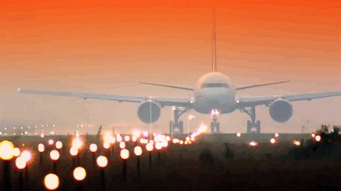
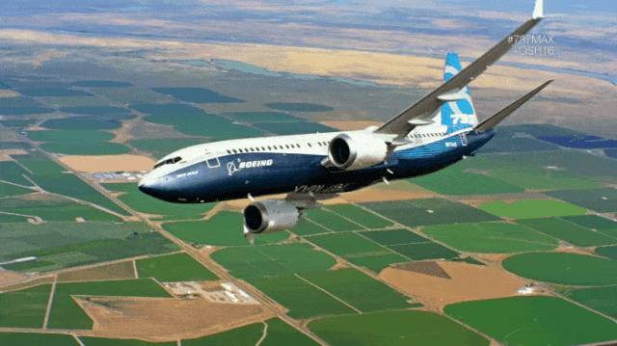
FLIGHT FARE ESTIMATION
REGRESSION PROJECT
BATCH -13-02-2023

Slide 2

Project Info
Identification of features and Collection of Data for the Project.
Cleaning and enriching data
Insights on Data @ EDA( Exploratory Data Analysis)
Statistics
Visualisations
Derived insights
Predictive Model Building for Estimation of Price
Model Evaluation & Real time Prediction

Slide 3

About the Data & Input, output variables
Received the sample dataset from Github via. (Social Pracher institute)
The dataset contains flight fares information from various sources and destinations
Input variables used for predictive model
Airline – type of airlines
Date of Journey – journey dates of passengers
Source – journey starting point
Destination – journey end point
Route– airline routes from different places
Departure Time – time of departure
Arrival Time – time of departure
Duration – total journey duration
Total Stops – no of stops
Additional info – extra baggage or luggage of passenger
Above variables chosen for model build are independent of each other
Model output variable
Price – flight fare

Slide 4
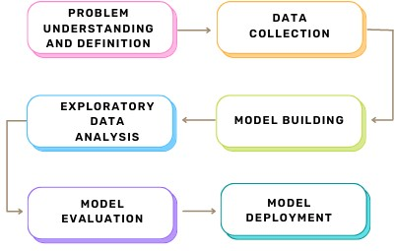
Data Cleaning & Enrichment of Data
So in data cleaning I followed date, time format for the Date of journey column
I extracted Journey day, Journey month and weekday from Date of journey column
Dropped the Route column because I am going to consider source and destination column further steps
In Duration column, I converted data into minutes so that we can do better visualizations
Same applied for the test dataset
Exploratory Data Analysis : Evaluated insights on the data .
- Insights on each column Data.
- Insights with respect to Y column.
Feature Engineering
Data Cleaning and Validation
Data Pre-Processing
Model Selection
Model Evaluation

Slide 5

Insights on Data (Stats+Visual)
Individual Column Data Study:
-Among all the airline, Air India has the highest number of passengers
-Delhi is the highest source city it having 41% of passengers
-Cochin is the highest destination city it having 41% of passengers
-According to the data morning is the most preferred departure time
-According to the data night is the most preferred arrival time
-50% of the flight duration is 505 minutes
-75% of the flights are 1 stop
-78% additional info doesn't have any information
-most of the passengers preferred journey day is Saturday
-most of the passengers preferred journey month is June

Slide 6
Insights on two columns:
-By seeing the bar plot in the month of march price is high compare to other months.
-As per the catplot New Delhi(Destination) is showing the highest price.
-As per the catplot Bangalore (source destination) is having the highest price.
-From the above diagram jet airways having the highest price compare to other airways.
-By seeing the above diagram we are unable write the insight so that we can consider other columns.
-Above barplot shows evening departure time having the highest price.
-Above barplot shows evening Arrival time having the highest price.
-so we all know that direct flight fares are high compare to multiple stop flights.
-As we see that 4(Friday) are the most expensive price compare to other days.

Slide 7
Insights on total analysis
Airline - Jet Airways
Source - New Delhi
Destination – Bangalore
Dep_Time – Evening
Arrival_Time – Evening
No_of_Stops – 1
Journey_Day – Saturday
Journey_Month – March
According to the dataset these are the findings . ( jet airways) airline have the highest price among all other airlines and (New Delhi)source , Destination (Bangalore) are the bit high price , (Evening) is the most preferred time to start the journey so obviously price is high , usually journey ends in (evening) most of the types because this in domestic journey dataset, highest duration was the 8 hours, preferred day for journey is (Saturday) because people are tend to travel on weekends , (March) month is the vacation time for all school, college students , so no of passengers are more on this month.

Slide 8
Predictive Modelling
Predictive modeling is a mathematical process used to predict future events or outcomes by analyzing patterns in a given set of input data.
The columns are selected according to the output column .
The Output column selected for the data set is price
The Input Column for the data is selected on the basis of price column , The Input column for the data set are
Airline
Date of Journey
Source
Destination
Route
Departure Time
Arrival Time
Duration
Total Stops
Additional info

Slide 9
Data Validation
Train and Test Split : Data is divided in train and test data for the model fitting and evaluation .
Train Data is used to train the model according to the requirements .
Test Data is used to test the model which we have trained in train data .
Train and Test Data can be extracted by train_test_split method, which divides more than 60% of data in train and remaining data in test by sampling method. We have used test size as 65%.

Slide 10
Inputs selected for my model
Data Exploration: Exploring the trained data set and test data set by using statistical measures and visualizations.
Missing values and Outliers : Missing values were handled in both train and test data by using measures of central tendency for numerical column and mode for categorical column.
Outliers are handled by replacing them lower quartile range and upper quartile range.
Feature Engineering : Creating new columns from the existing columns that makes more informative about the data set.
Feature Scaling : the process of normalizing the range of features in a dataset . Some methods of scaling are standard scalar , normalized Scalar.

Slide 11
Data Transformation
* It’s essential to convert all the features into numeric type .
* For categorical data , The data is divided into either nominal data or ordinal data.
For the data set ,
Nominal data- Airlines, Source, Destination, Additional info
Ordinal data-Dep time, Arrival time, Journey month
(Label Encoding for ordinal)
(One hot encoding for nominal)

Slide 12
Model Training
There are different kind of models for the data set depending on the Output Variable.
Here, the output variable is Delivery Time . We will be using Regression models . As, the output column is of numerical data type.
The models used for this project are :
- Multiple Linear Regression.
- Polynomial Regression
- Lasso and Ridge
- Random Forest Regressor
- XGB Regressor

Slide 13
Evaluation(Model Selection)
Model Evaluation is done by loss and Performance of the model.
Loss metrics is evaluated by mean squared error.
Performance metrics is evaluated by r2 Score.
loss metrics accuracy metrics
Multiple Linear Regression - 0.68 0.71
Polynomial Regression - 0.51 0.48
Lasso & Ridge - 0.67 0.70
Random Forest Regressor - 0.97 0.85
XGB regressor - 0.94 0.87
Basically for me every model is a good fit
I choose Random Forest Regressor because it having train score & test score are good fit compare to other models

Slide 14

Real Time Prediction
User Given Data:
Airline – Jet airways
Source- Bangalore
Destination- New Delhi
Arrival time – 675
Departure time – 678
Duration – 2h 30m
No of stops – 2
Additional info- No info
Date of journey – 23
Date of month -3
Weekday - 5
data=['Jet Airways’, 'Bangalore’, 'New Delhi',675,678,'2h 30m',2,'No info',23,3,5]
-After onehot coding and label encoding I got the price for the user given input
Estimated Price= 17433.18
-So this will be the price according to the user

